Slide 1
Blockchain Introduction
Client: Hoang Le Minh Mentor: Vo Dong Thanh Tin
Members: Pham Huynh Tri Minh – Nguyen Trong Tri

Slide 2
Agenda
Blockchain characteristics:
Peer-to-peer.
Transparency.
Immutable.
Robustness.
Decentralized.
Validation:
Hash.
Digital Signature.
Mining.
Proof of Work.
Conflict.
Notes:
Introduce about 2 things: Blockchain characteristic and How to Validation a transaction.

Slide 3

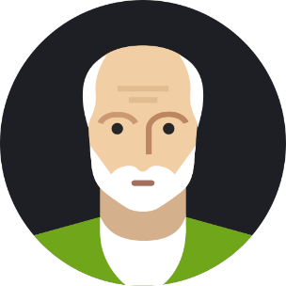



Peer-to-peer architecture.
Fast.
Doesn’t cost for third-person.
-> Inconvenient to exchange cash all the time.
=> Need something to store all the exchanges to record transactions between them and count the balance later.
Notes:
Why (people invent a blockchain technology)?
Use cryptocurrency to explain how blockchain concept was created.
Assume that Bob, Alice, Eve and Charlie exchange money very frequently (share bills, pay for merchandises or give free money, …)
->It’s peer-to-peer architecture, they transfer their money directly to the other.
->It’s fast and doesn’t cost money for any third person.
->But inconvenient to exchange cash all the time.
->Need something to store all the exchanges to record transactions between them and count the balance later.

Slide 4



Ledger
Alice pays Bob 50$.
Bob pays Charlie 10$.
Eve pays Alice 30$.
Eve pays Charlie 40$.
….
Notes:
Use a ledger to record all transactions
So, basically, they write all the exchanges into a book, called a ledger.
It’s placed in public, such as a website, so that everyone can access and add new line of transaction anytime and anywhere.
-> Transparency.
At the end of a month, if you received more than you spent, you put a money into the pot and if you spent more than you received, you take the money out.
->Sound great and convenient, but what if someone try to fake an exchange by adding new line without everyone acknowledge?
->Digital signature (Secret Key – Public Key, SHA256, Hash).

Slide 5
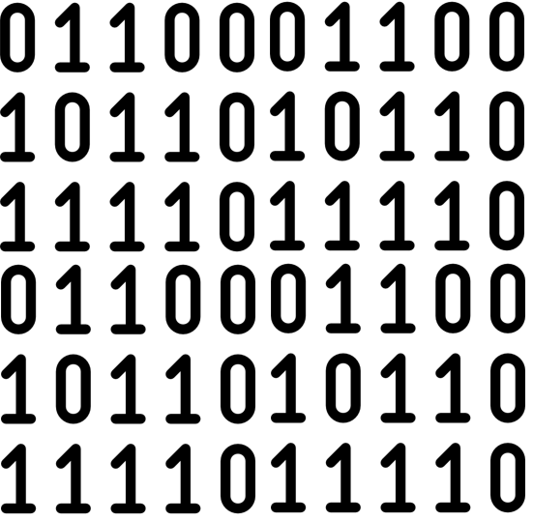

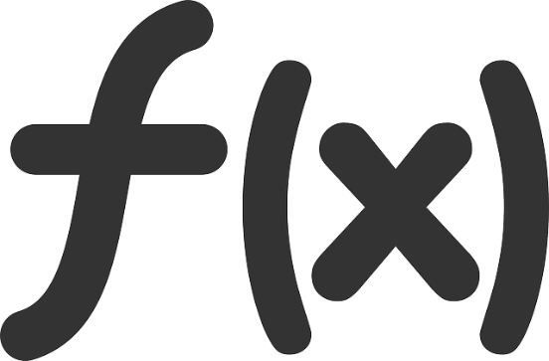
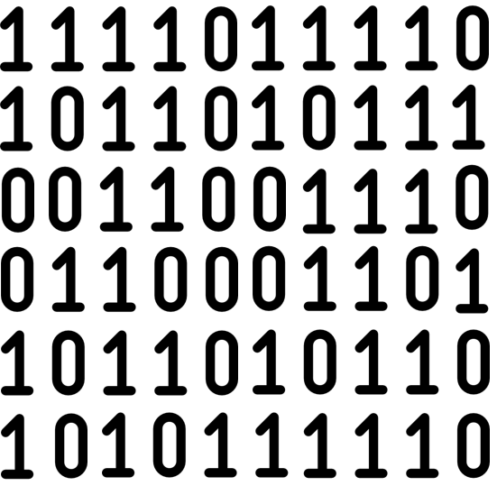

Hello World
World Hello You
Notes:
What is a hash function?
First, we have to look at the hash function. What is a hash function? It is a one-way function to encrypt everything (messages, transactions, applications, …) into a binary string. For 1 message, there is only one binary string, which means when you change a little in that message, the output string will completely different.
It can’t be reversed from a binary string to the message. It uses SHA256 algorithm so the only way to find out the message is guessing and checking. But, the change is very small [ 1/ (2^256) ~ 0], so it’s very secure.

Slide 6
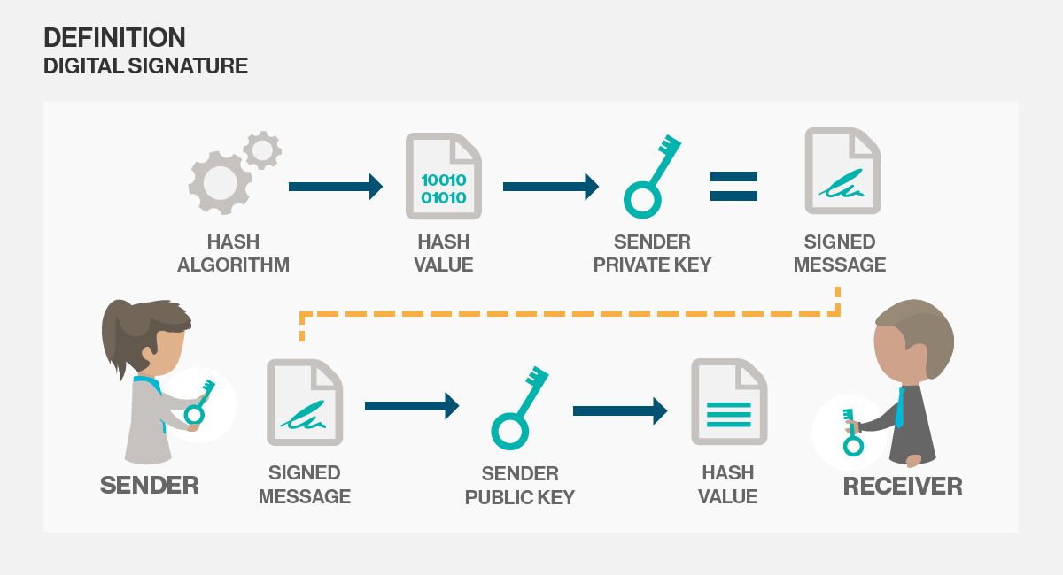

Slide 7

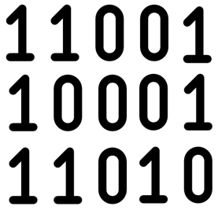

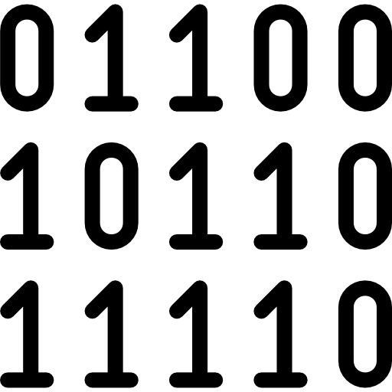
Sign( , Secret Key) =
Sign( ,Secret Key) =
Verify( , , Public Key) =
True/False
Notes:
How digital signature can prevent fake transactions?
In the real world, we sign the same signature in every paper.
For the digital signature, to prevent the copied signature, each person will have 2 keys: Secret key (only you know it) and Public key.
When you make a transaction, you use the Secret key and that transaction to generate a digital signature. When you want to check whether the sender is the owner, you use that signed transaction with the Public key to check it is true or not.
->Now we can know the truly owner of each transaction and no one can change or make a new line relate to us without our knowledge. But, what if it is damaged or lost?
->Decentralize.

Slide 8
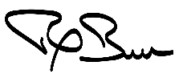

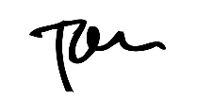
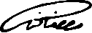
Ledger
Alice pays Bob 50$.
Bob pays Charlie 10$.
Eve pays Alice 30$.
Eve pays Charlie 40$.
….
Notes:
Remove trust on the third-party and robustness.
As we had mention before, the ledger is put at a public place, like a website. Who is the host, who will take the responsibility when incidents happen, we should trust them or not?
To remove the third-party and maintain the accessibility of the ledger, each person has a copied ledger and they keep synchronize and update it individually.
->Now, our ledger, database, is secure, immutable and endure. But, how can we so sure that all people have the same database.
->Validation – Mining.

Slide 9

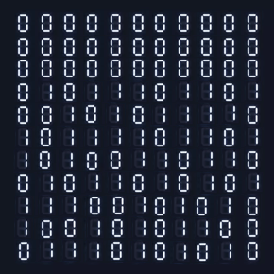
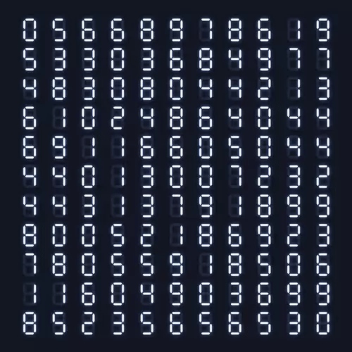
Block #70509
Block #70509
Block #70509
Block #70509
Charlie pay Bob 5$
Block #70509
Bob pays Alice 10$
Bob pays Alice 10$
Bob pays Alice 10$
Bob pays Alice 10$
Bob pays Alice 10$
Charlie pay Bob 5$
Charlie pay Bob 5$
Charlie pay Bob 5$
Charlie pay Bob 5$
Eve pays Charlie 20$
Eve pays Charlie 20$
Eve pays Charlie 20$
Eve pays Charlie 20$
Alice pays Charlie 15$
Alice pays Charlie 15$
Alice pays Charlie 15$
Alice pays Charlie 15$
Eve pays Charlie 20$
Alice pays Charlie 15$
Notes:
When you want to make a transaction, you have to broadcast to everyone in the network. The miner will collect all of the transactions and put them into a block (per 10m like bitcoin) then start to solve the puzzle.
The puzzle is finding a number, with it, the hash will have about 30 first bit is 0. Who (the miner) find that number first will earn some rewards and add it to the ledger (database) so that everyone will base on that and update their ledger.
->It creates the cryptocurrency in the network, make sure everyone has the same database.
->If 2 miners find the number at the same time, what block we should trust?

Slide 10
A ledger
(Blockchain Database)
Block #70509
Block #70510
Block #70511
Block #70512
Block #70513
Transactions
Transactions
Transactions
Transactions
Transactions
Special Number
Special Number
Special Number
Special Number
Special Number
Header (Block hash)
Header (Block hash)
Header (Block hash)
Header (Block hash)
Header (Block hash)
Previous Block
Previous Block
Previous Block
Previous Block
Previous Block
Notes:
Inside a ledger

Slide 11
How new blocks add into a blockchain database after be mined
Notes:
What it looks like when a miner add new blocks into blockchain database (a ledger)

Slide 12
When a conflict happens
what line we should trust.
Notes:
Conflict, trust the longest line

Slide 13
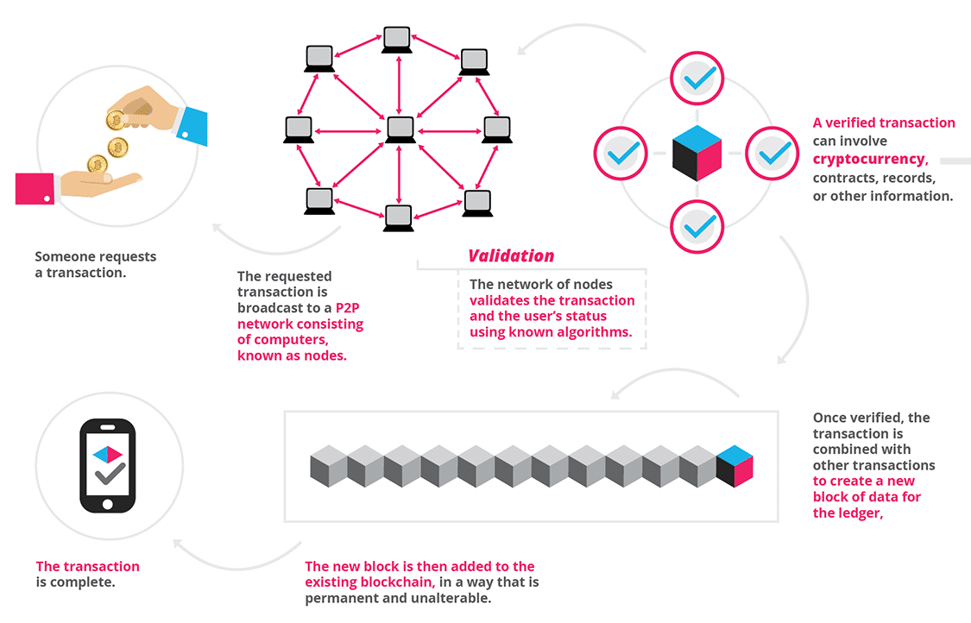
We went though:
Blockchain:
Peer-to-peer.
Transparency.
Decentralized.
Robustness.
Immutable.
Validation:
Mining.
Solve conflict.
How Cryptocurrency is created and reason to use it.
Notes:
Summary

Slide 14
Question & Answer

